Slide 1

How to Use this Slide Deck
[Last Updated 08.20.2015]
What’s Included?
Instructional and exercise slides for the LabVIEW Student Ambassadors
End of lesson quiz questions
Exercises that are designated “Homework” exercises
What’s Excluded?
Sections involving hardware

Slide 3
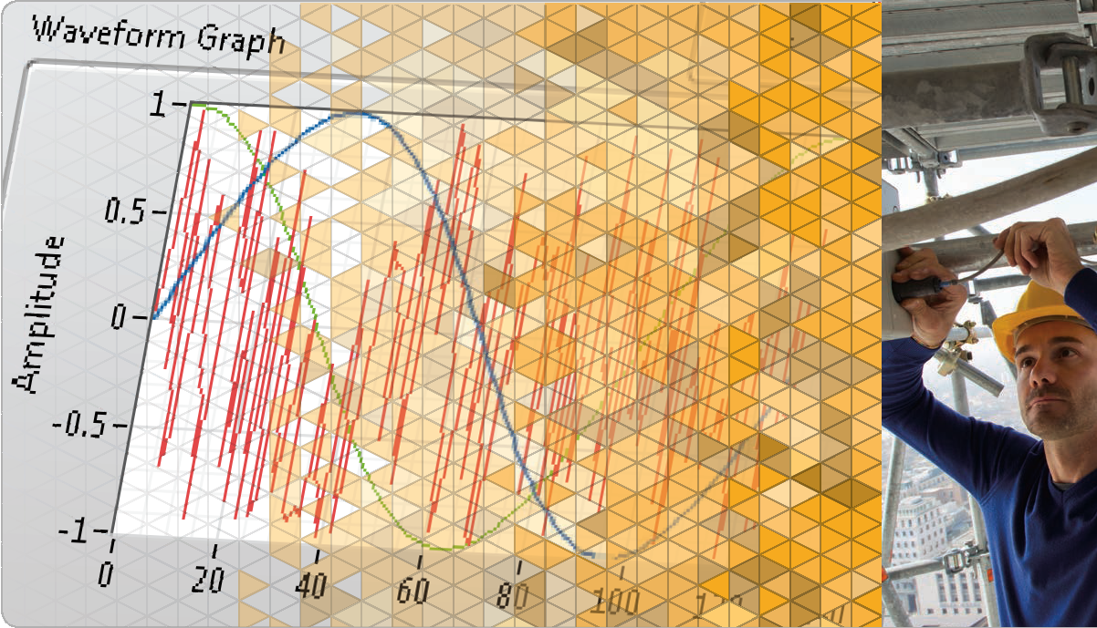
LabVIEW Core 1
Notes:
The slides from here to the first lesson slide are the standard front matter for any course. Any text in red should be replaced with text appropriate to your course.

Slide 4
Welcome to LabVIEW Core 1
Course Learning Map
Lesson 1
Troubleshooting and Debugging VIs
Lesson 4
Lesson 2
Navigating LabVIEW
Creating Your First Application
Lesson 3
Using Loops
Lesson 5
Modularity
Lesson 6
Creating and Leveraging Data Structures
Using Decision-Making Structures
Lesson 7
Lesson 8
Using Sequential and State Machine Programming
Lesson 9
Acquiring Measurements with Hardware
Accessing Files in LabVIEW
Lesson 10
Notes:
<Replace text with your lesson titles. Click each smart art, press the left expand icon, and add or remove Lessons as needed. Resize the smart art to fit the actual number of lessons.>

Slide 5
Lesson 5
Creating and Leveraging Data Structures
Create, manipulate and use arrays, clusters, and type definition controls for data access and analysis.
Arrays
Common Array Functions
Polymorphism
Auto-Indexing
Clusters
Type Definitions

Slide 6
E. Clusters
Identify when to use clusters and be able to create them.
Reasons To Use Clusters
Cluster vs. Arrays
Creating a Cluster Control and Constant
Ordering Items and Resizing Clusters
Disassembling and Modifying Clusters
Plotting Data

Slide 7
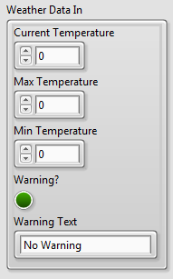
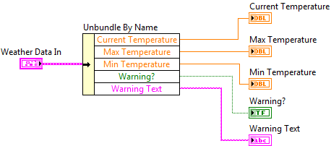
E. Clusters
Clusters
Clusters group data elements of mixed types.
Clusters are similar to a record or a struct in text-based programming languages.
Notes:
Additional items to mention:
Bundling several data elements into clusters eliminates wire clutter on the block diagram and reduces inputs and outputs for subVIs.
Most clusters on the block diagram have a pink wire and data type terminal.
Clusters of numeric values, sometimes referred to as points, have a brown wire and data type terminal.
You can wire brown numeric clusters to Numeric functions to perform the same operation simultaneously on all elements of the cluster.

Slide 8
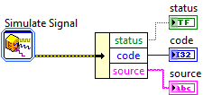

E. Clusters
Clusters vs. Arrays
Clusters
Mixed data types
Fixed size
Arrays
One data type
Vary in size

Slide 9
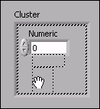
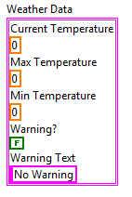
Create a Cluster Control
.

Slide 10
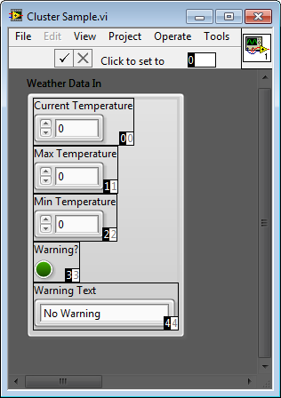
E. Clusters
Cluster Order
Cluster elements have a logical order unrelated to their position in the shell.

Slide 11
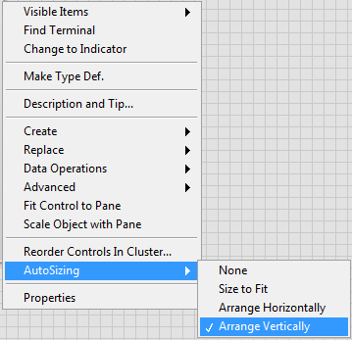
E. Clusters
Autosizing Clusters
Arrange elements in clusters
NI recommends:
Arrange vertically
Arrange elements compactly
Arrange elements in preferred order

Slide 12

E. Clusters
Disassembling Clusters
Unbundle By Name
Use if all elements have names.
Unbundle
Use if some or all cluster elements are unnamed.

Slide 13
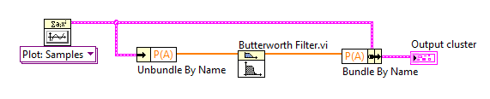
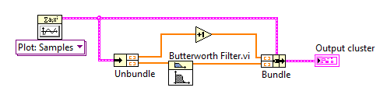
E. Clusters
Modifying a Cluster
Bundle By Name
access elements in a cluster.
Bundle
some or all cluster elements are unnamed.
You must wire the input cluster terminal.

Slide 14

Creating a Cluster on the Block Diagram

Slide 15
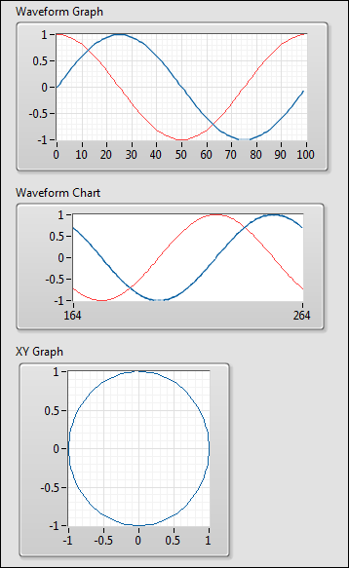
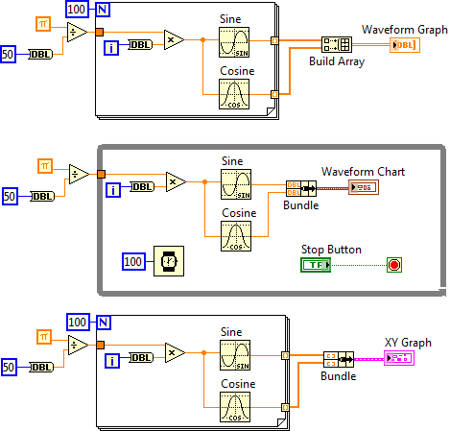
E. Clusters
Multi-plot Graphs/Charts and XY Graph
Notes:
The Bundle function is often used to create multi-chart plot charts and XY plots.
The Build Array function is used to create multi-plot waveform graphs.

Slide 16
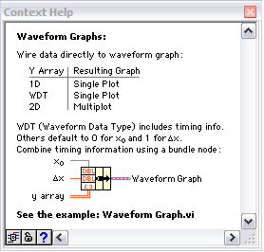
E. Clusters
Plotting Data
Use the Context Help window to determine how to wire multi-plot data to Waveform Graphs, Charts, and XY Graphs.
Notes:
Use the Context Help and shipping examples to investigate all the possible ways to assemble data for various graphical displays.
LabVIEW examples and help provide extensive information on wiring data to the various graphical displays.

Slide 17
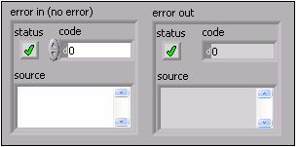
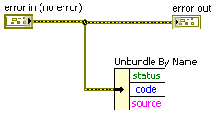
E. Clusters
Error Clusters
An error cluster contains the following elements:
status
code
source

Slide 18
Exercise 5-2
Temperature Warnings VI─ Clusters
Create clusters, reorder clusters, and use the cluster functions to assemble and disassemble elements.

Slide 19
Exercise 5-2
Temperature Warnings VI─ Clusters
What would happen if you reordered cluster elements?
What would happen if you added a cluster element to Weather Data Out?
Notes:
What would happen if you reordered cluster elements?
Both the subVI and calling VI would continue to work as expected since the only cluster functions used are Unbundle By Name and Bundle By Name. A change to element order in a cluster does not break these functions.
What would happen if you added a cluster element to Weather Data Out?
Both the subVI and the calling VI would be broken because of mismatching cluster data types.

Slide 20
F. Type Definitions
Identify and determine when to use a type definition, strict type definition, or control.

Slide 21
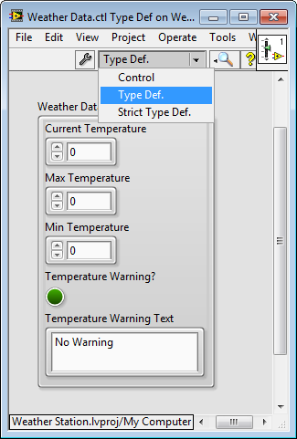
F. Type Definitions
Control Options
You can save a custom control as:
Control
Type Definition
Strict Type Definition
Notes:
LabVIEW has three kinds of custom controls (.ctl files):
A regular custom control
Used to create controls that behave like existing controls but look different.
A type def or type definition control
Used for changing all instances of a linked control in a single edit.
A strict type def control
Used for changing instances in a single edit.
Used to ensure all instances have same appearance.

Slide 22
Difference between Control, Type Def, and Strict Type Def

Slide 23
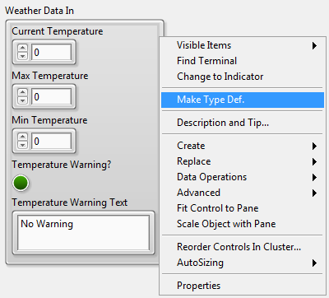

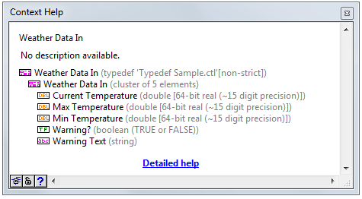
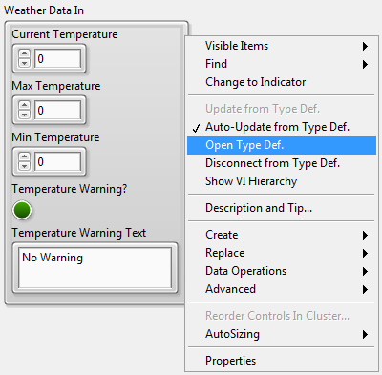
Creating and Identifying Type Definitions (Type Def)

Slide 24
Exercise 5-3
Temperature Warnings VI─ Type Definition
Create and modify a type-defined cluster control and use the type definition in a calling VI and a subVI.
Notes:
This exercise explores the differences between a type definition and a strict type definition.

Slide 25
Exercise 5-3
Temperature Warnings VI─ Type Definition
Now that the Weather Data control is saved as a type definition, how many instances of the cluster would need to be updated to add wind speed data?
Notes:
Now that the Weather Data control is saved as a type definition, how many instances of the cluster would need to be updated to add wind speed data?
One. You add elements to the type definition. Apply and save changes.
Converting from a cluster to a type definition requires a one-time update to each cluster. However, once you have your data in a type definition, adding or removing elements is a simple update to the type definition control.

Slide 26

Activity 5-2
Lesson Review
Refer to the participant guide to answer questions about what you have learned in this lesson and then discuss the answers as a group.

Slide 27
Lesson Review
You can create an array of arrays.
True
False
Notes:
Answer is False.

Slide 28
Lesson Review
You can create an array of arrays.
True
False
You cannot drag an array data type into an array shell. However, you can create two-dimensional arrays.

Slide 29
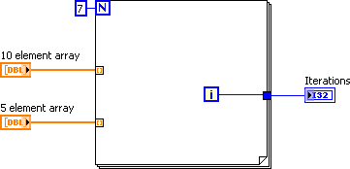
Lesson Review
What is the value of the Iterations indicator after running this VI?
Notes:
Answer is 4.

Slide 30
Lesson Review
What is the value of the Iterations indicator after running this VI?
4
Notes:
LabVIEW does not exceed the array size. This helps to protect against programming error. So the loop runs 5 times.
Although the for loop runs 5 times, the iterations are zero-based. Therefore the value of the Iterations indicators is 4.

Slide 31
Lesson Review
Which of the following custom control settings defines the data type of all instances of a control but allows for different colors and font styles?
Control
Type definition
Strict type definition
Cluster control
Notes:
Answer is b.

Slide 32
Lesson Review
Which of the following custom control settings defines the data type of all instances of a control but allows for different colors and font styles?
Control
Type definition
Strict type definition
Cluster control
Notes:
A standard type definition ensures that all instances of the control use the same data type but allows for flexibility in colors and font styles. A strict type definition is similar to a type definition but forces everything to be identical except label, description and default value. There is no connection between a custom control and the instance of a custom control. Therefore selecting control does not define the data type of all instances.

Slide 33
Lesson Review
You have input data representing a circle: X Position (I16), Y Position (I16), and Radius (I16). In the future, you might need to modify your data to include the color of the circle (U32). What data structure should you use to represent the circle in your application?
Three separate controls for the two positions and the radius
A cluster containing all of the data
A custom control containing a cluster
A type definition containing a cluster
An array with three elements
(X,Y)
R
Notes:
Answer is d.

Slide 34
Lesson Review
You have input data representing a circle: X Position (I16), Y Position (I16), and Radius (I16). In the future, you might need to modify your data to include the color of the circle (U32). What data structure should you use to represent the circle in your application?
Three separate controls for the two positions and the radius
A cluster containing all of the data
A custom control containing a cluster
A type definition containing a cluster
An array with three elements
(X,Y)
R
Notes:
Answer is d.

Slide 35
Lesson 6
Using Decision-Making Structures
Learn to create different decision-making structures and be able to identify applications where using these structures can be beneficial.
Case Structures
Event-Driven Programming

Slide 36
A. Case Structures
Recognize and use the basic features and functionality of Case Structures.
Case Structures Review
Creating and Configuring Case Structures
Selector Terminal Data Types
Input and Output Tunnels

Slide 37
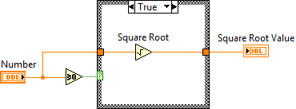
Activity 6-1
Case Structures Review
Case Selector Label
Selector Terminal

Slide 38
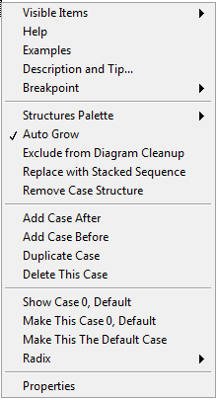
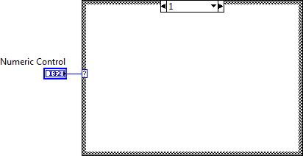
Case Structures
Create and configure case structures.

Slide 39
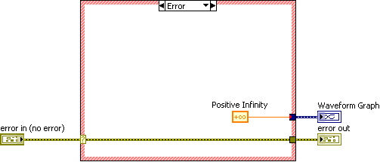
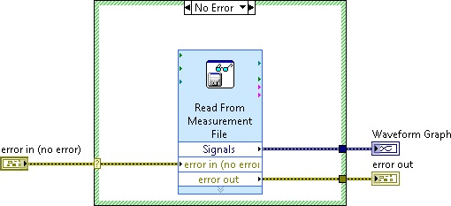
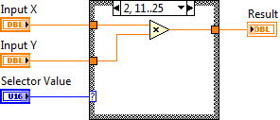
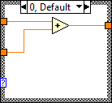
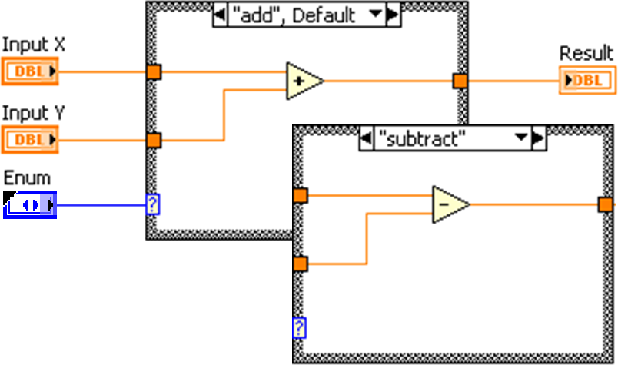
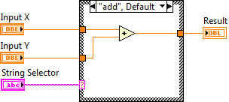
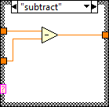
A. Case Structures
Selector Terminal Data Types

Slide 40
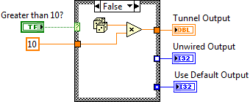
A. Case Structures
Input and Output Tunnels
Input tunnels are available to all cases if needed.
You must define every output tunnel for each case.

Slide 41
Selector Terminal Types and Tunnels
Create Case structures using different data type selectors.
Create different types of output tunnels.

Slide 42
Exercise 6-1
Temperature Warnings with Error Handling
Modify a VI to use Case structures to make a software decision.

Slide 43
Exercise 6-1
Temperature Warnings with Error Handling
What happens if all the values are 10? How could you fix this?
Are all output tunnels defined? What happens if an output is not defined?

